Slide 1
Entity-Relationship Model

Slide 2
Entity-Relationship Model
facilitate database design
Allow specification of enterprise schema that represents the overall logical structure of a database.

Slide 3
  Models an enterprise as a collection of entities and relationships
    Entity:
      a “thing” or “object” in the enterprise
      distinguishable from other objects
      Described by a set of attributes
    Relationship: an association among several entities
  Represented diagrammatically by an entity-relationship diagram:

Slide 4
Entity Sets
An entity is an object that exists and is distinguishable from other objects.
  Example: specific person, company, event, plant
An entity set is a set of entities of the same type that share the same properties.
  Example: set of all people who are instructors at a given university deﬁned as the entity set instructor
  An entity is represented by a set of attributes; i.e., descriptive properties possessed by all members of an entity set.
  Each entity has a value for each of its attributes
  Example:
  instructor = (ID, name, street, city, salary )
  course= (course_id, title, credits)
A subset of the attributes form a primary key of the entity set; i.e., uniquely identifiying each member of the set.

Slide 5

Entity Sets -- instructor and student
instructor_ID instructor_name student-ID student_name

Slide 6
Relationship
A relationship is an association among several entities
Example:
45565 (Katz) advisor 12345 (Shankar)
instructor entity relationship student entity

Slide 7
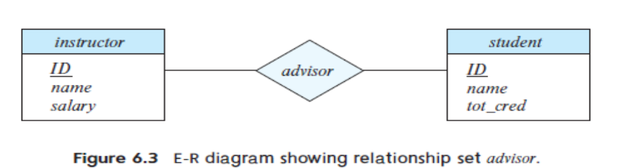
Relationship Sets
A relationship set is a set of relationships of the same type.
A relationship set is a mathematical relation among n ≥ 2 entities, each taken from entity sets.
If E1, E2,...,En are entity sets, then a relationship set R is a subset of {(e1,e2,...,en)|e1 ∈ E1,e2 ∈ E2,...,en ∈ En} where (e1,e2,...,en) is a relationship.

Slide 8

Relationship Set advisor

Slide 9

descriptive attributes
relationship may also have attributes called descriptive attributes.
An attribute can also be associated with a relationship set.
For instance, the advisor relationship set between entity sets instructor and student may have the attribute date which tracks when the student started being associated with the advisor

Slide 10
Degree of a Relationship Set
binary relationship
  involve two entity sets (or degree two).
  most relationship sets in a database system are binary.
Relationships between more than two entity sets are rare. Most relationships are binary.
Example: students work on research projects under the guidance of an instructor.
  relationship proj_guide is a ternary relationship between instructor, student, and project

Slide 11
Attributes
descriptive properties possessed by all members of an entity set.
set of permitted values, called the domain, or value set, of that attribute
E-R model attribute types.
Simple and composite attributes
Single-valued and multivalued attributes
Derived attribute

Slide 12
Attribute types:
  Simple - can not divide into subparts eg- instructor_ID
  composite - can be divided into subparts eg-
    Name-ﬁrst name, middle initial, and last name
    Address- street number, street name, and apartment number
  Single-valued - student ID attribute for a speciﬁc student entity refers to only one student ID.
  multivalued (composite ) attributes-
    phone number attribute.
    instructor may have zero, one, or several phone numbers, and different instructors may have different numbers of phones.
Domain – the set of permitted values for each attribute

Slide 13

Composite Attributes

Slide 14
  Derived attributes
    Can be computed from other attributes
    Example: age, given date_of_birth
    can calculate age from date of birth and the current date.
      date of birth referred to as a base attribute, or a stored attribute.
      The value of a derived attribute is not stored but is computed when required
An attribute takes a null value when an entity does not have a value for it.

Slide 15
Constraints

Slide 16
Mapping Cardinality ( cardinality ratios) Constraints
Express the number of entities to which another entity can be associated via a relationship set.
Most useful in describing binary relationship sets.
For a binary relationship set the mapping cardinality must be one of the following types:
  One to one
  One to many
  Many to one
  Many to many

Slide 17
One-to-one. An entity in A is associated with at most one entity in B, and an entity in B is associated with at most one entity in A.
  Eg- instructor may advise at most one student, and a student may have at most one advisor.
One-to-many. An entity in A is associated with any number (zero or more) of entities in B. An entity in B, however, can be associated with at most one entity in A
  Eg- an instructor may advise many students, but a student may have at most one advisor.

Slide 18

Mapping Cardinalities
One to one
One to many
Note: Some elements in A and B may not be mapped to any
elements in the other set

Slide 19
Many-to-one. An entity in A is associated with at most one entity in B. An entity in B, however, can be associated with any number (zero or more) of entities in A.
  an instructor may advise at most one student, but a student may have many advisors.
• Many-to-many. An entity in A Associated with any number(zero or more) of entities in B, and an entity in B is associated with any number (zero or more) of entities in A.
eg- an instructor may advise many students, and a student may have many advisors.

Slide 20

Mapping Cardinalities
Many to one
Many to many
Note: Some elements in A and B may not be mapped to any
elements in the other set

Slide 21
Weak Entity Sets
Consider a section entity, which is uniquely identified by a course_id, semester, year, and sec_id.
Clearly, section entities are related to course entities. Suppose we create a relationship set sec_course between entity sets section and course.
Note that the information in sec_course is redundant, since section already has an attribute course_id, which identifies the course with which the section is related.
One option to deal with this redundancy is to get rid of the relationship sec_course; however, by doing so the relationship between section and course becomes implicit in an attribute, which is not desirable.

Slide 22
Entity-Relationship Diagrams

Slide 23
express the overall logical structure of a database graphically
. E-R diagrams are simple and clear

Slide 24
Basic Structure

Slide 25

An E-R diagram consists of the following major components:
Rectangles -represent entity sets.
divided into two parts
      ﬁrst part- name of the entity set
      second part -the names of all the attributes of the entity set.
      Attributes that are part of the primary key are underlined.

Slide 26


      Diamonds- relationship sets
      Undivided rectangles – the attributes of a relationshipset.

Slide 27
      Lines- link entity sets to relationship sets.
      Dashed lines -link attributes of a relationship set to the relationship set.
      Double lines indicate total participation of an entity in a relationship set.

Slide 28

Total and Partial Participation
Total participation (indicated by double line): every entity in the entity set participates in at least one relationship in the relationship set
  participation of student in advisor relation is total
    every student must have an associated instructor
Partial participation: some entities may not participate in any relationship in the relationship set
  Example: participation of instructor in advisor is partial

Slide 29

Roles
Entity sets of a relationship need not be distinct
  Each occurrence of an entity set plays a “role” in the relationship
The labels “course_id” and “prereq_id” are called roles.

Slide 30

Cardinality Constraints
We express cardinality constraints by drawing either a directed line (→), signifying “one,” or an undirected line (—), signifying “many,” between the relationship set and the entity set.
One-to-one relationship between an instructor and a student :
  A student is associated with at most one instructor via the relationship advisor
  An intstructor is associated with at most one student via advisor

Slide 31
One-to-Many Relationship
one-to-many relationship between an instructor and a student
  an instructor is associated with several (including 0) students via advisor
  a student is associated with at most one instructor via advisor,

Slide 32
Many-to-One Relationships
In a many-to-one relationship between an instructor and a student,
  an instructor is associated with at most one student via advisor,
  and a student is associated with several (including 0) instructors via advisor

Slide 33
Many-to-Many Relationship
An instructor is associated with several (possibly 0) students via advisor
A student is associated with several (possibly 0) instructors via advisor

Slide 34

Notation to Express Entity with Complex Attributes

Slide 35

Notation for Expressing More Complex Constraints
A line may have an associated minimum and maximum cardinality, shown in the form l..h, where l is the minimum and h the maximum cardinality
  A minimum value of 1 indicates total participation.
  A maximum value of 1 indicates that the entity participates in at most one relationship
  A maximum value of * indicates no limit.
Instructor can advise 0 or more students. A student must have 1 advisor; cannot have multiple advisors

Slide 36
Participation Constraints
The participation of an entity set E in a relationship set R is said tobe
total –if every entity in E participates in atleast one relationship inR.
Partial -some entities in E participate in relationships in R
every student entity to be related to at least one instructor through the advisor relationship. -participation of student in the relationship set advisor is total
an instructor need not advise any students. Hence, it is possible that only some of the instructor entities are related to the student entity set through the advisor relationship, and the participation of instructor in the advisor relationship set is therefore partial

Slide 37
Weak Entity Sets (Cont.)
An entity set that does not have sufﬁcient attributes to form set.
An entity set that has a primary key is termed a strong entity set.
weak entity set one whose existence is dependent on another entity, called its identifying entity;
instead of associating a primary key with a weak entity, we use the identifying entity, along with extra attributes called discriminator to uniquely identify a weak entity.
An entity set that is not a weak entity set is termed a strong entity set.

Slide 38
Weak Entity Sets (Cont.)
Every weak entity must be associated with an identifying entity;
the weak entity set is said to be existence dependent on the identifying entity set.
The identifying entity set is said to own the weak entity set that it identifies.
The relationship associating the weak entity set with the identifying entity set is called the identifying relationship.
The discriminator of a weak entity set is a set of attributes that allows this distinction to be made
The discriminator of a weak entity set is also called the partial key of the entity set.
The primary key of a weak entity set is formed by the primary key of the identifying entity set, plus the weak entity set’s discriminator

Slide 39
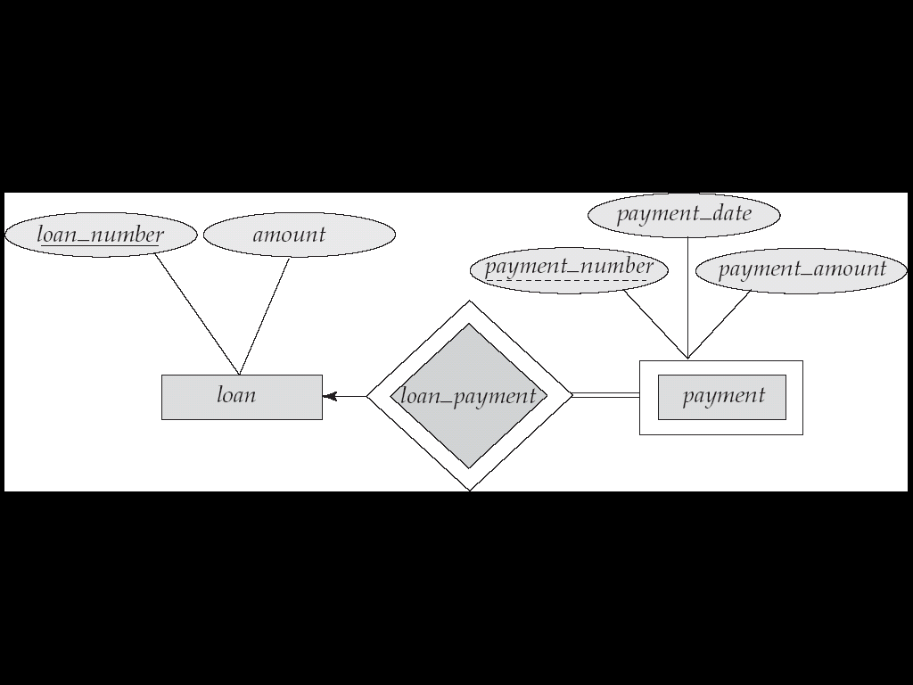
Weak Entity Sets (Another Example)
We depict a weak entity set by double rectangles.
We underline the discriminator of a weak entity set with a dashed line.
payment_number – discriminator of the payment entity set
Primary key for payment – (loan_number, payment_number)

Slide 40
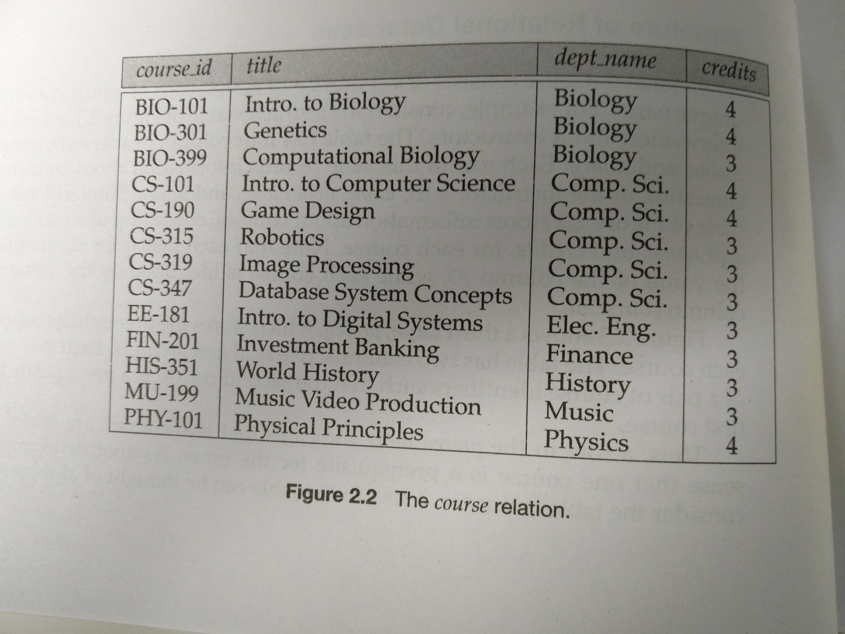

Slide 41
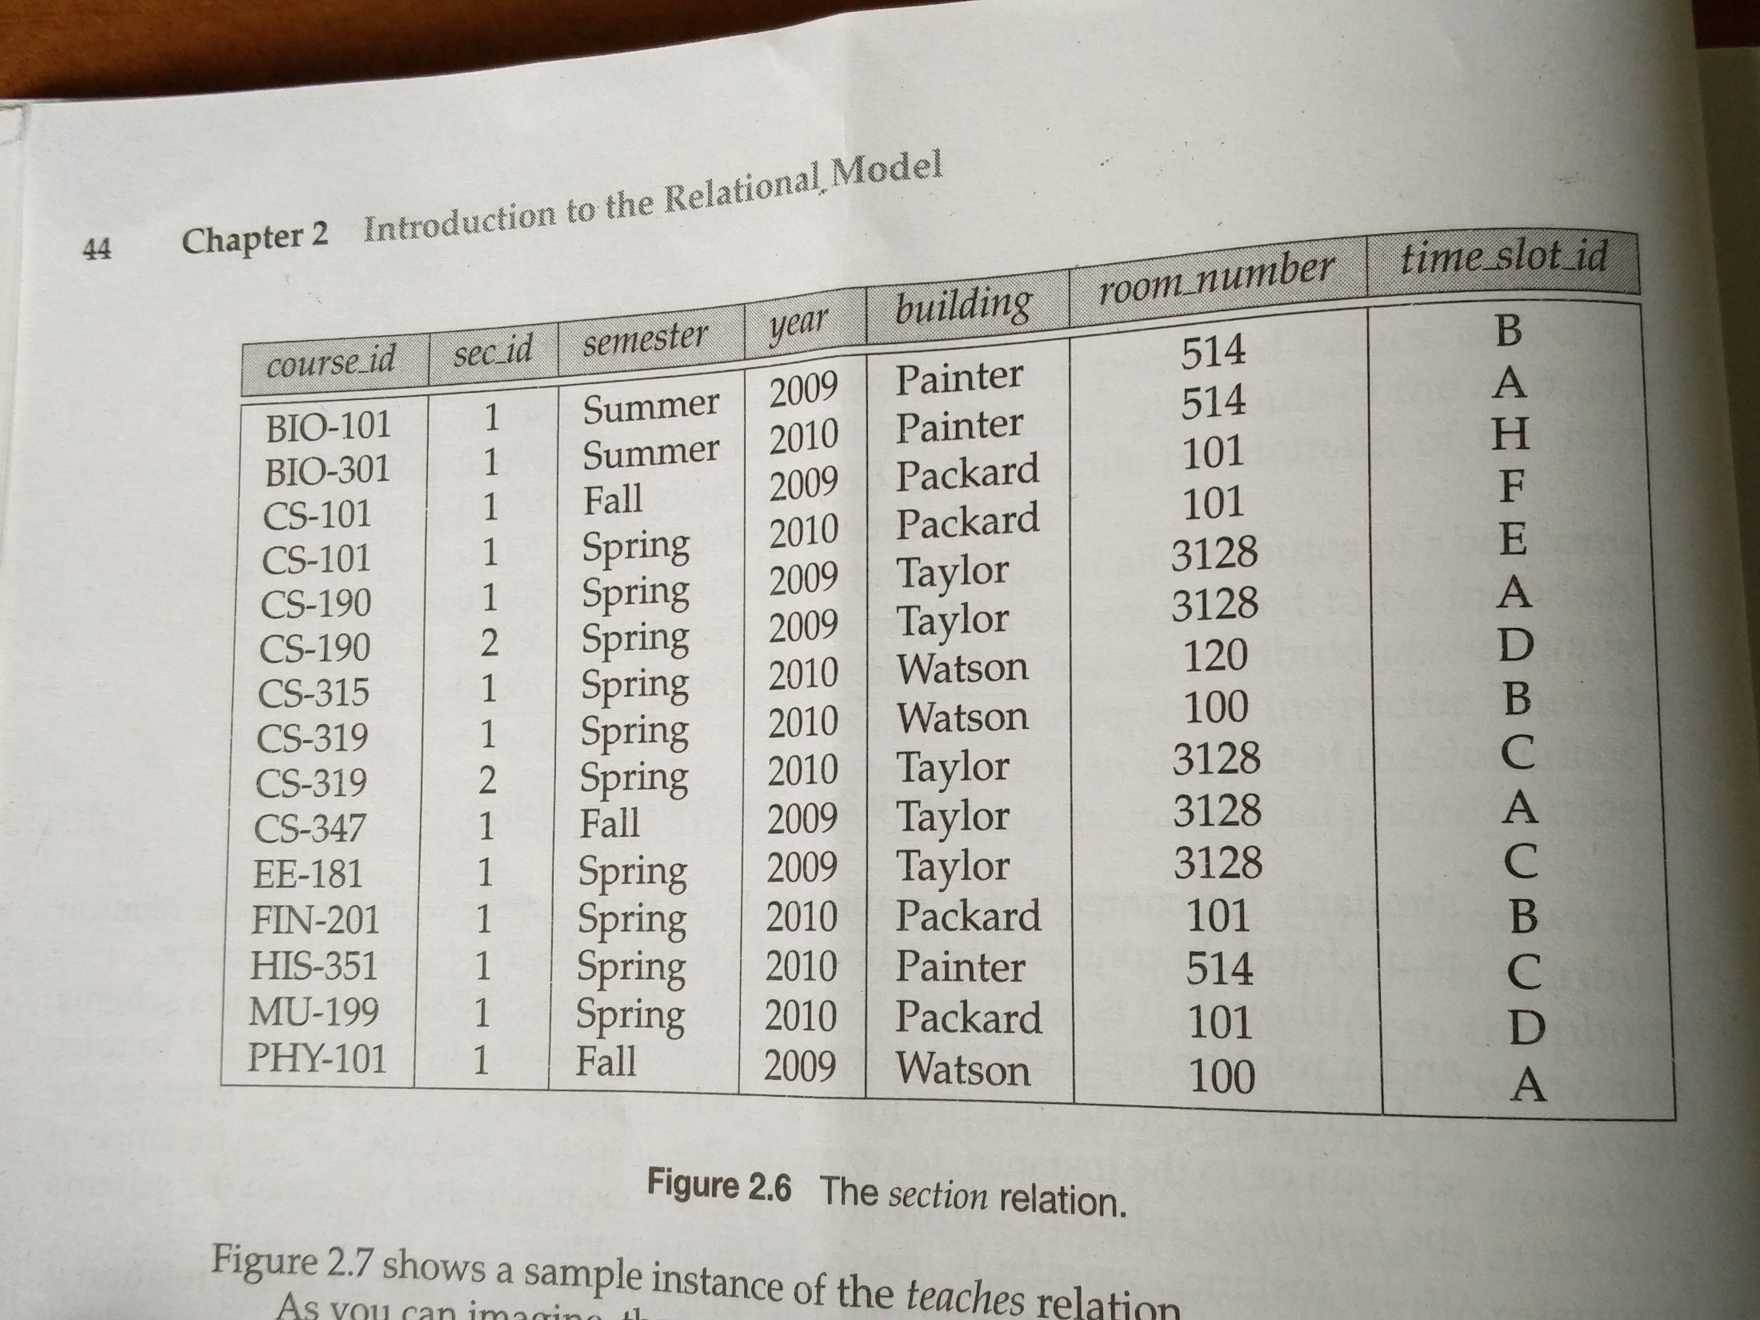

Slide 42

      Double diamonds represent identifying relationship sets linked to weak entity sets
Primary key for section – (course_id, sec_id, semester, year)

Slide 43
In E-R diagrams, a weak entity set is depicted via a rectangle, like a strong entity set, but there are two main differences:
• The discriminator of a weak entity is underlined with a dashed, rather than a solid, line.
• The relationship set connecting the weak entity set to the identifying strong entity set is depicted by a double diamond.

Slide 44

E-R Diagram for a University Enterprise

Slide 45
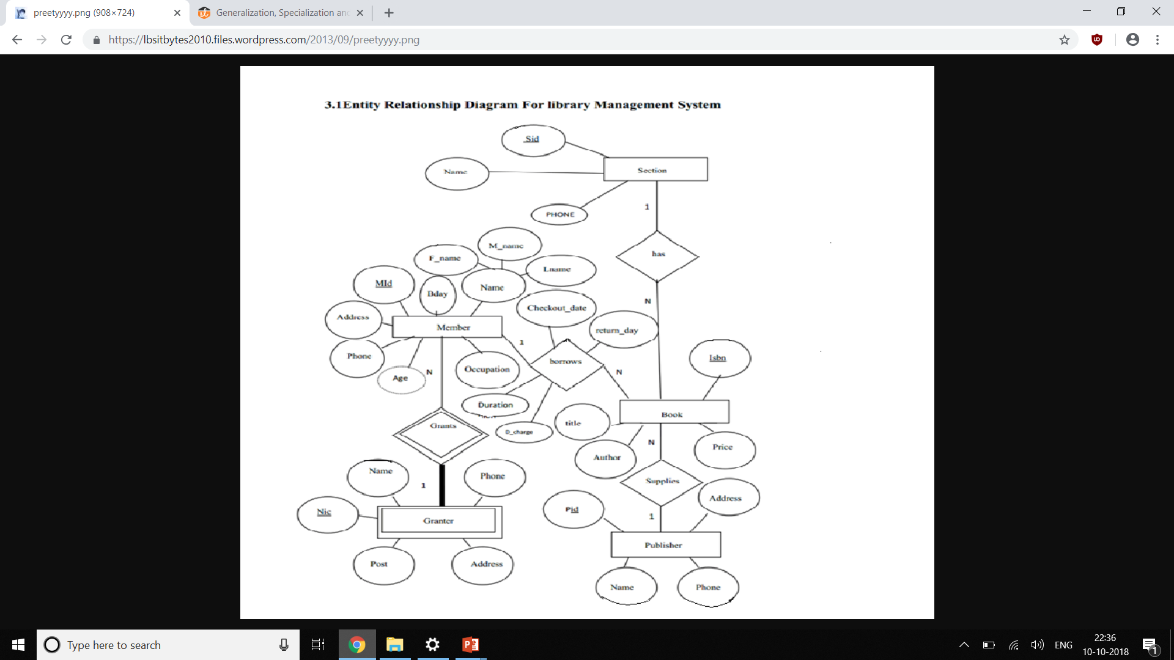

Slide 46
Reduction to Relation Schemas

Slide 47
We can represent a database that conforms to an E-R database schema by a collection of relation schemas.
For Each entity set and for each relationship set in the database design, there is a unique relation schema to which we assign the name of the corresponding entity set or relationship set.
Both the E-R model and the relational database model are abstract
we can convert an E-R design into a relational design.
Each schema has a number of columns (generally corresponding to attributes), which have unique names.

Slide 48
Representation of Strong Entity Sets with Simple Attributes
Let E be a strong entity set with only simple descriptive attributes a1, a2,...,an.
represent this entity set by a schema called E with n distinct attributes.
Each tuple in a relation -corresponds to one entity of the entity set E.
primary key of the entity set serves as the primary key of the resulting schema.
A strong entity set reduces to a schema with the same attributes
student(ID, name, tot_cred)
student ‘ID’ is the primary key of the entity set, is also the primary key of the relation schema.

Slide 49
Representation of Strong Entity Sets with Complex Attributes
For composite attributes –create a separate attribute for each of the component attributes;
Eg -instructor entity set
name→ composite attribute,
ﬁrst name,
middle name
last name;
create a separate attribute for each of them
there is no separate attribute or schema for name.
  Eg if avoiding multi valued attribute Phone number,the schema will be
  instructor(ID,
  first_name, middle_initial, last_name,
  street_number, street_name, apt_number, city, state, zip_code,
  date_of_birth)

Slide 50
Handling multivalued attributes
For a multivalued attribute M, create a relation schema R with an attribute A that corresponds to M and attributes corresponding to the primary key of the entity set or relationship set of which M is an attribute.
Eg -multivalued attribute phone number.
The primary key of instructoris ID.
For this multivalued attribute, create a relation schema
instructor phone (ID, phone number)
Each phone number of an instructor represented as a unique tuple in the relation on this schema.
Eg instructor with ID 22222, and phone numbers 555-1234 and 555-4321,the relation instructor phone have two tuples(22222, 555-1234) and (22222, 555-4321).

Slide 51
Representing weak Entity Sets
A weak entity set becomes a table that includes a column for the primary key of the identifying strong entity set
section ( course_id, sec_id, sem, year )
Also need to set a foreign key constraint in ‘section’ references the table on which ‘section’ depends (here ‘course’)

Slide 52
Representing weak Entity Sets….
Let A be a weak entity set with attributes a1, a2, . . . , am.
Let B be the strong entity set on which A depends.
Let the primary key of B consist of attributes b1, b2, . . . , bn.
We represent the entity set A by a relation schema called A with
one attribute for each member of the set:
{a1, a2, . . . , am} ∪ {b1, b2, . . . , bn}

Slide 53
Representing Relationship Sets
Let R be a relationship set,
let a1,a2,...,am be the set of attributes formed by the union of the primary keys of each of the entity sets participating in R,
Descriptive attributes(if any) of R be b1,b2,...,bn.
represent this relationship set by a relation schema called R with one attribute for each member of the set: {a1,a2,...,am}∪{b1,b2,...,bn}

Slide 54
Representing Relationship Sets
A many-to-many relationship set is represented as a schema with attributes for the primary keys of the two participating entity sets, and any descriptive attributes of the relationship set.
Example: schema for relationship set advisor
advisor = (s_id, i_id)

Slide 55
• For a binary one-to-one relationship set, the primary key of either entity set can be chosen as the primary key.
• For a binary many-to-one or one-to-many relationship set, the primary key of the entity set on the“many”sideof the relationship set serves as the primary key.
For an n-ary relationship set without any arrows on its edges,the union of the primarykey- attributes from the participating entity sets becomes the primary key. •
For an n-ary relationship set with an arrow on one of its edges, the primary keys of the entitysets not on the “arrow” side of the relationship set serve as the primary key for the schema.

Slide 56

Redundancy of Schemas
Many-to-one and one-to-many relationship sets that are total on the many-side can be represented by adding an extra attribute to the “many” side, containing the primary key of the “one” side
Example: Instead of creating a schema for relationship set inst_dept, add an attribute dept_name to the schema arising from entity set instructor

Slide 57
Redundancy of Schemas (Cont.)
For one-to-one relationship sets, either side can be chosen to act as the “many” side
  That is, an extra attribute can be added to either of the tables corresponding to the two entity sets
If participation is partial on the “many” side, replacing a schema by an extra attribute in the schema corresponding to the “many” side could result in null values

Slide 58
Redundancy of Schemas (Cont.)
The schema corresponding to a relationship set linking a weak entity set to its identifying strong entity set is redundant.
Example: The section schema already contains the attributes that would appear in the sec_course schema

Slide 59

Non-binary Relationship Sets
Most relationship sets are binary
There are occasions when it is more convenient to represent relationships as non-binary.
E-R Diagram with a Ternary Relationship

Slide 60
Cardinality Constraints on Ternary Relationship
We allow at most one arrow out of a ternary (or greater degree) relationship to indicate a cardinality constraint
For exampe, an arrow from proj_guide to instructor indicates each student has at most one guide for a project

Slide 61
Extended E-R Features

Slide 62
Specialization
An entity set may include subgroupings of entities
Subgroups distinct in some way
each subset may have attributes that are not shared by all the entities in the entity set.
In E-R model we can representing these distinctive entity groupings.
example,
the entity set person may be further classiﬁed as one of the following:
• employee.
• student.

Slide 63
person - described by a set of attributes that includes all the attributes of entity set person plus possibly additional attributes.
For example,
employee entities may be described further by the attribute salary,
student entities may be described further by the attribute tot cred.
The process of designating subgroupings within an entity set is called specialization.
a person could be an employee, a student, both, or neither.

Slide 64
Specialization
Top-down design process; we designate sub-groupings within an entity set that are distinctive from other entities in the set.
These sub-groupings become lower-level entity sets that have attributes that do not apply to the higher-level entity set.
Two specializations of student, namely graduate and undergraduate.
Depicted by a triangle component labeled ISA (e.g., instructor “is a” person).
Attribute inheritance – a lower-level entity set inherits all the attributes and relationship participation of the higher-level entity set to which it is linked.

Slide 65

Specialization is depicted by a hollow arrow-head pointing from the specialized entity to the other entity
This relationship as the IS A relationship
specialization relationship may also be referred to as a superclass-subclass relationship

Slide 66
Types of Specialization
Overlapping –
entity may belong to multiple specialized entity sets
two separate arrows are used
employee and student
Disjoint –
belong to at most one specialized entity set
a single arrow is used
instructor and secretary
Total and partial

Slide 67
Representing Specialization via Schemas
Method 1:
  Form a schema for the higher-level entity
  Form a schema for each lower-level entity set, include primary key of higher-level entity set and local attributes
  Drawback: getting information about, an employee requires accessing two relations, the one corresponding to the low-level schema and the one corresponding to the high-level schema
schema attributes
person ID, name, street, city
student ID, tot_cred
employee ID, salary

Slide 68
Representing Specialization as Schemas (Cont.)
Method 2:
  Form a schema for each entity set with all local and inherited attributes
  Drawback: name, street and city may be stored redundantly for people who are both students and employees
schema attributes
person ID, name, street, city
student ID, name, street, city, tot_cred
employee ID, name, street, city, salary

Slide 69
Generalization
A bottom-up design process – combine a number of entity sets that share the same features into a higher-level entity set.
Specialization and generalization are simple inversions of each other; they are represented in an E-R diagram in the same way.
The terms specialization and generalization are used interchangeably.

Slide 70
instructor entity set -instructor id, instructor name, instructor salary, and rank.
• secretary entity set -secretary id, secretary name, secretary salary, and hours per week.
several attributes same across the two entity sets:
  the identiﬁer,
  name,
  salary
  commonality can be expressed by generalization
  Employee is the higher-level entity set
  Instructor and secretary are lower-level entity sets.

Slide 71
a hierarchy of entity sets.
single inheritance & multiple inheritance
Higher level entity sets – superclass
lower-level entity sets –subclass
eg
person entity set –superclass
employee and student - subclasses.

Slide 72
Constraints on Generalizations
Database designer may choose to place certain constraints on a particular generalization. One type of constraint involves determining which entities can be the members of lower entity.
Condition-deﬁned. lower-level entity sets, membership is evaluated on the basis of whether or not entity satisﬁes an explicit condition or predicate
not constrained by a membership condition; rather, the database user assigns entities to a given entity set.
User-deﬁned

Slide 73
Constraints on Generalizations
Second type of constraint involves determining whether or not entities may belong to more than one lower entity set.
1.Disjoint. A disjointness constraint requires that an entity belong to no more than one lower-level entity set
2. Overlapping.
same entity may belong to more than one lower-level entity set within a single generalization

Slide 74
Total generalization or specialization.
- Each higher-level entity must belong to a lower-level entity set
• Partial generalization or specialization.
- Some higher-level entities may not belong to any lower-level entity set.

Slide 75
Reduction to Relation Schemas
Representation of Generalization
Two different methods of designing relation schemas for an E-R diagram that includes generalization
  Create a schema for the higher-level entity set.
  For each lower-level entity set, create a schema includes an attribute for each of the attributes of that entity set plus one for each attribute of the primary key of the higher-level entity set. we have three schemas:
Eg: person (ID, name, street, city)
employee (ID, salary)
student (ID, tot cred)

Slide 76
The primary-key attributes of the higher-level entity set become primarykey attributes of the higher-level entity set as well as all lower-level entity sets.
In addition, we create foreign-key constraints on the lower-level entity sets, with their primary-key attributes referencing the primary key of the relation created from the higher-level entity set.
In the above example, the ID attribute of employee would reference the primary key of person, and similarly for student.

Slide 77
2.
A) If the generalization is disjoint and complete—
If no entity is a member of two lower-level entity sets directly below a higher-level entity set ,and if every entity in the higher-level entity set is also a member of one of the lower-level entity sets.
  Here, do not create a schema for the higher-level entity set.
Instead, for each lower level entity set, we create a schema- includes an attribute for each of the attributes of that entity set plus one for each attribute of the higher-level entity set.
Eg: employee (ID, name, street, city, salary)
student (ID, name, street, city, tot cred)
Both these schemas have ID,which is the primary-key of the higher level entity set person, as their primary key.

Slide 78
Drawback of the second method-
A) deﬁning foreign-key constraints.
B) If the second method were used for an overlapping generalization, some values would be stored multiple times, unnecessarily.
C) If the generalization were disjoint but not complete —.
that is, if some person is neither an employee or a student—then an extra schema
person (ID, name, street, city) would be required to represent such people

Slide 79
university divides students into two categories:
graduate (an ofﬁce assigned to them)
undergraduate (assigned to a residential college)
  student - ID, name, address, and tot_cred.
graduate - an additional attribute ofﬁce number.
undergraduate -additional attribute residential college.
university employees may be further classiﬁed as one of the following:
• instructor.
• secretary.
Each employee types is described by a set of attributes that includes all the attributes of entity set employee plus additional attributes.
For example,
instructor -attribute rank
secretary -hours per week.

Slide 80
Aggregation
Limitation of the E-R model is that it cannot express relationships among relationships

Slide 81
Eg-
each instructor guiding a student on a project is required to ﬁle a monthly evaluation report
Model the evaluation report as an entity evaluation, with a primary key evaluation id.
create a quaternary(4-way) relationship set eval_ for between instructor, student, project, and evaluation
The best way to model a situation such as the one just described is to use aggregation
Aggregation is an abstraction through which relationships are treated as higher-level entities

Slide 82


Slide 83
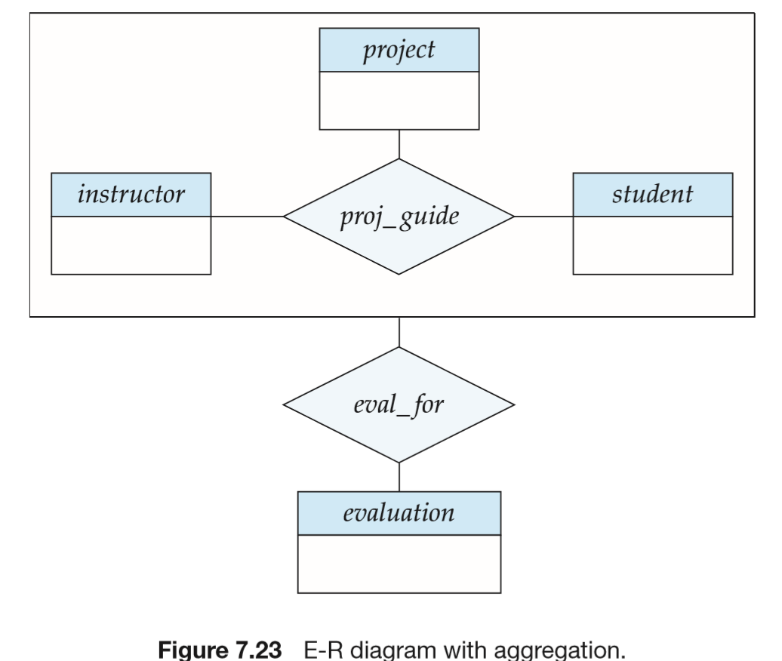

Slide 84
Representing Aggregation via Schemas
To represent aggregation, create a schema containing
  Primary key of the aggregated relationship,
  The primary key of the associated entity set
  Any descriptive attributes
In our example:
  The schema eval_for is:
  eval_for (s_ID, project_id, i_ID, evaluation_id)

Slide 85

Summary of Symbols Used in E-R Notation

Slide 86
Symbols Used in E-R Notation (Cont.)

Slide 87

Alternative ER Notations
Chen IDE1FX (Crows feet notation)

